Slide 2
Why do we need a Center for AI?
AI is perhaps the most revolutionary technology ever invented
  Changing the fundamentals of science and healthcare
  Superhuman performance is already here
  Lack of synergy: AI plus Human is not 1+1 = 2
  Casual use of AI can result in deskilling or never skilling
Opportunities to collaborate?

Slide 3
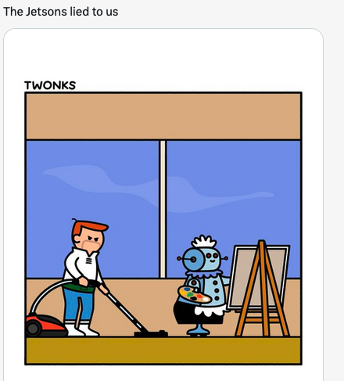
We need a Center at Rutgers Health to create the future we want

Slide 4
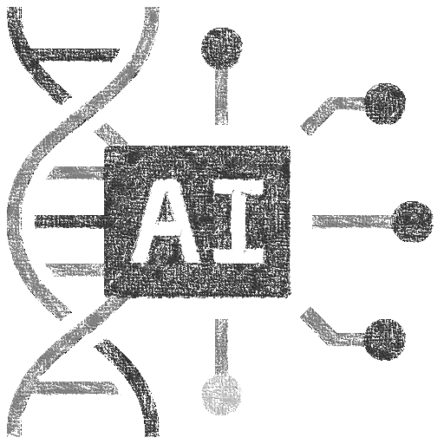













We best create this future by building bridges across all of Rutgers Health

Slide 5


“Ethical Plus” AI: Ethical, synergistic, skills enhancing
Living
Laboratories
Digital
Twins
An AI-enabled Learning
Health and Research System
An AI-enabled Medical
and Science Education System

Slide 6
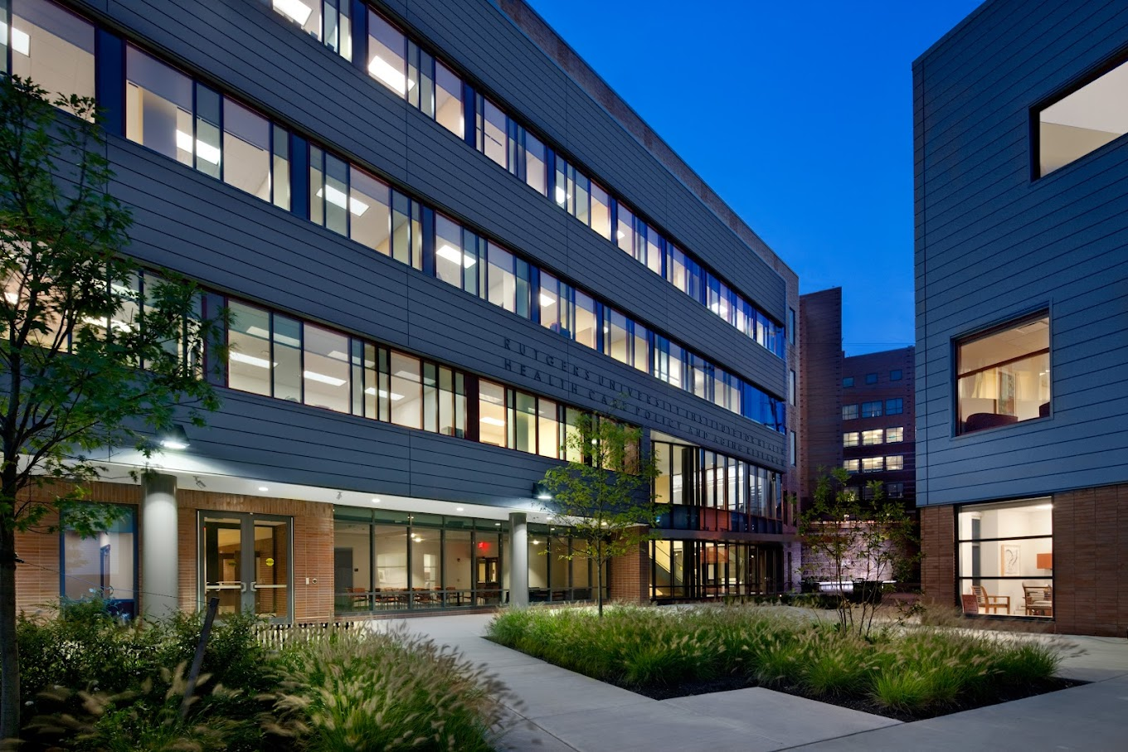
The (Short) History of the BMIHAI
Center for Biomedical Informatics &
Health AI (BMIHAI) was established on
Oct 3rd, 2024 (using Roadmaps and
Chancellor funds)
First symposium health in Spring of 2025
First grants/educational programs in June of 2025
Inaugural Director Leslie Lenert appointed
Nov 1, 2025

Slide 7

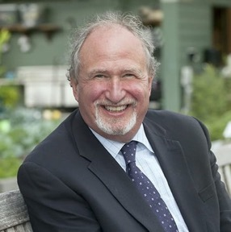
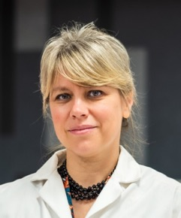
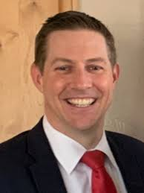
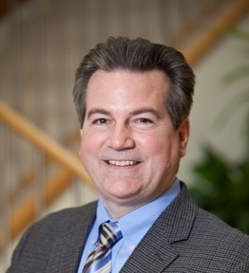
https://ifh.rutgers.edu/center-for-biomedical-informatics-and-health-artificial-intelligence/
Leslie Lenert
Director, BMIHAI
Professor, Department of Medicine, Robert Wood Johnson Medical School
Antonina Mitrofanova
Deputy Director, BMIHAI
Associate Dean for Research,
School of Health Professions
Evan Johnson
Associate Director for
Basic Science and
Entrepreneurship, BMIHAI
Director, Center for Data Science, NJMS
David Foran
Associate Director for
Translational Technology and Solutions, BMIHAI
Chief Informatics Officer, Rutgers Cancer Institute

Slide 8
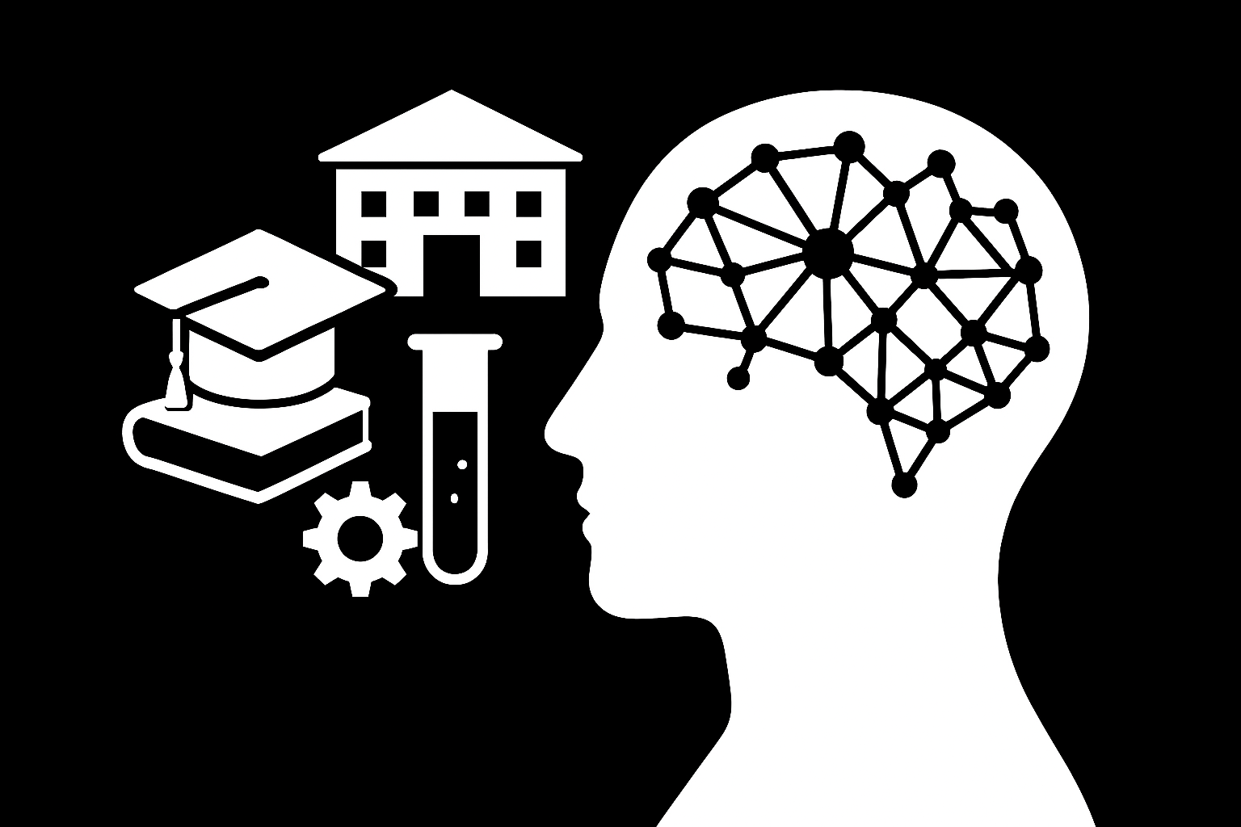
Foundational Pillars of
BMIHAI
Education, Training, and Community:
Cutting-edge degree programs, internships, and
specialized training in bioinformatics and AI to prepare the next generation of healthcare and biomedical researchers.
Social-Technical Infrastructure: Building Living Laboratories integrate clinical, educational, research, and commercial environments.
Research & Innovation:
Driving research that leverages AI and
machine learning to develop new insights, enhance diagnostics, and
improve health
outcomes.

Slide 9
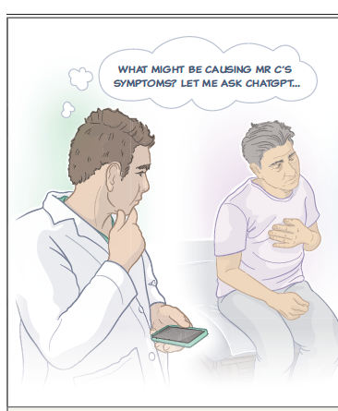
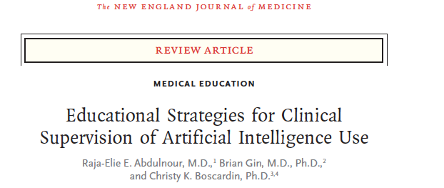

Avoiding de-skilling/Never
Skilling with AI
Loss of skills or the failure to develop
fundamental skills in the setting of AI
decision support.

Slide 10
Actions: Educational Programs
New PhD track in BM-AI
Program starts Fall 2026
(new 5 courses developed and approved)
Collaboration between
- School of Graduate Studies
School of Health Professions
New Jersey Institute of Technology
Highlights:
47 applications, 10 acceptances
and 7 commitments
Direct admits: 7 PIs across Rutgers Health:
- 2 from RWJMS (NB)
- 2 from Nursing School (NB)
- 1 from NJMS (Newark)
- 2 from SHP (Newark)
PhD in Health AI
Sustainability: program director shared
between SGS and SHP

Slide 11
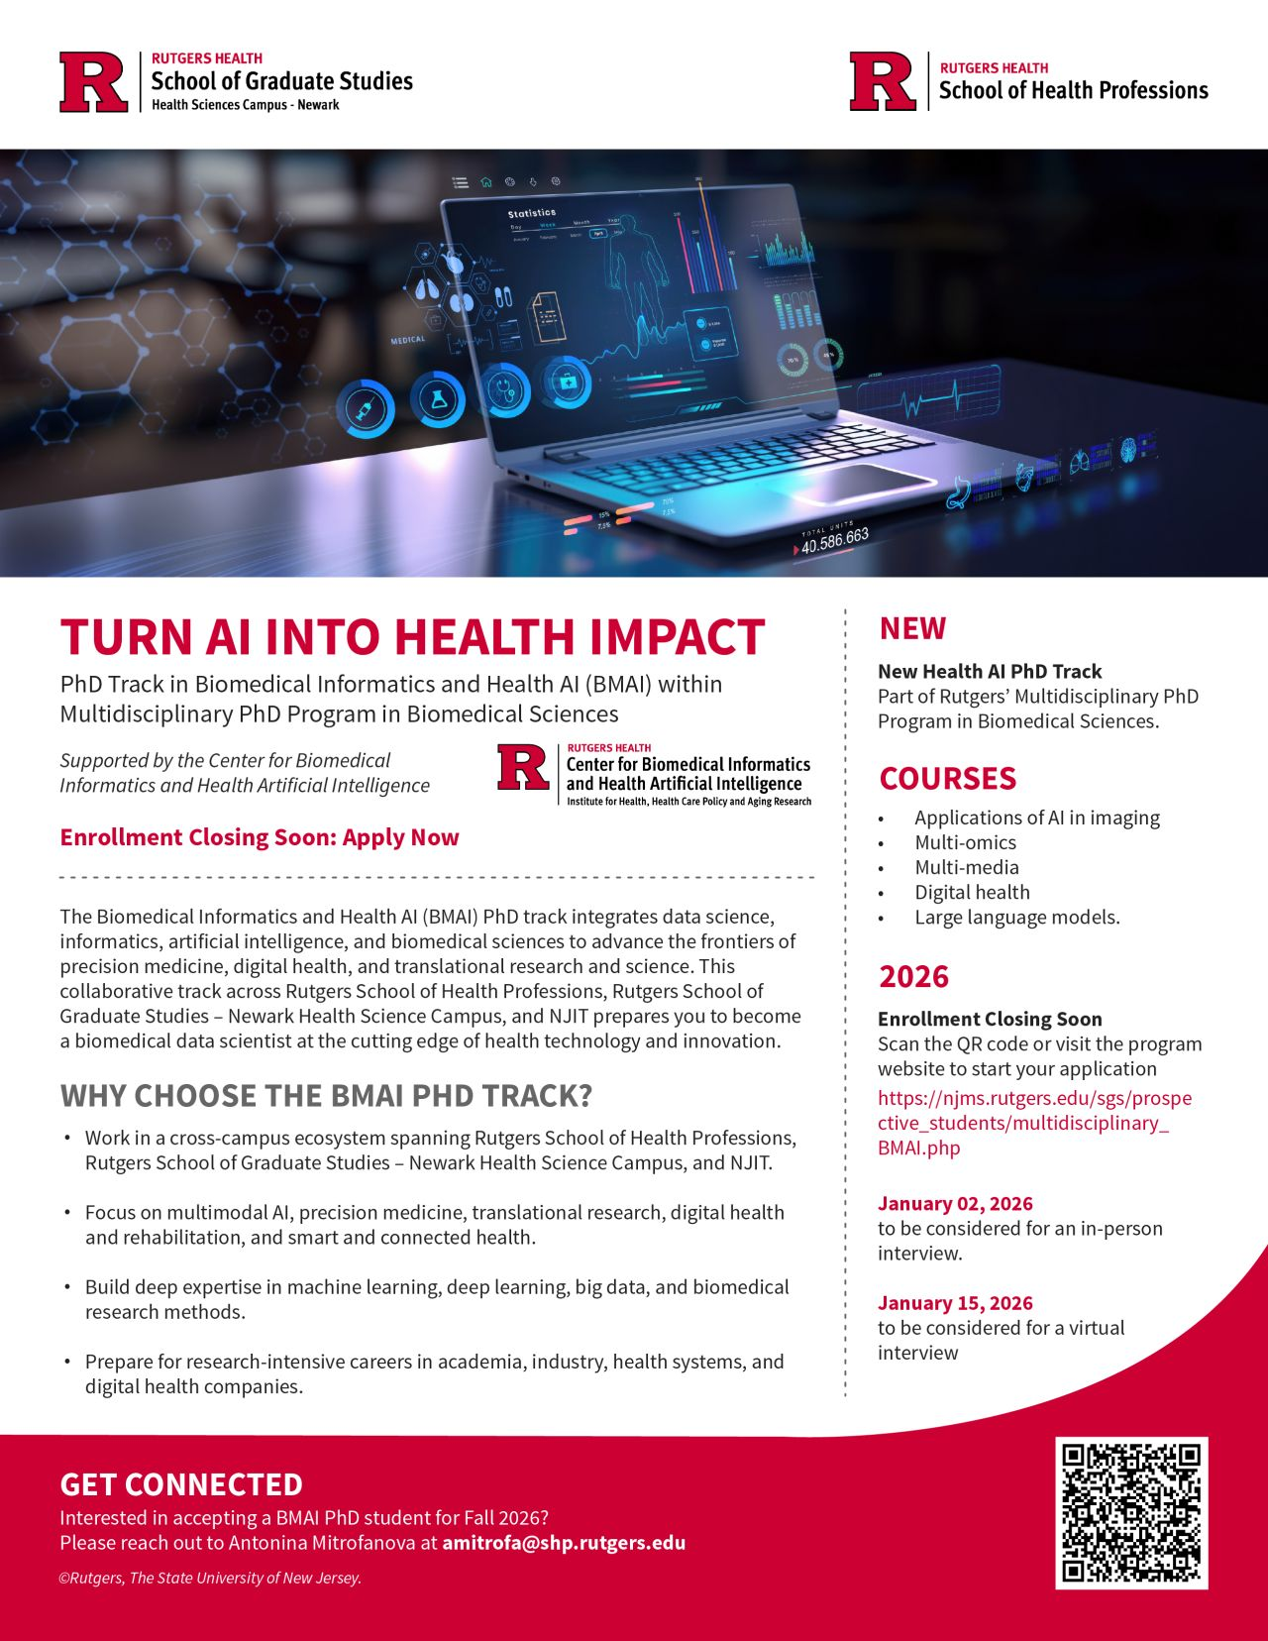
Actions: Educational Programs

Slide 12
Educational Programs
PhD in Health AI
MS in AI Healthcare
MS in AI in Healthcare track
Approved and to start Fall 2026
Deadline June 15: 110 applicants up to date (20 will be accepted)
Sustainability: program director fully
supported by SHP

Slide 13
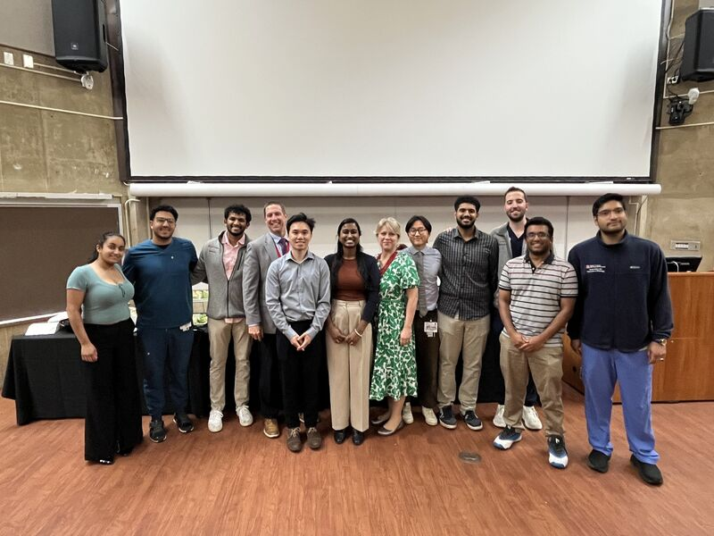
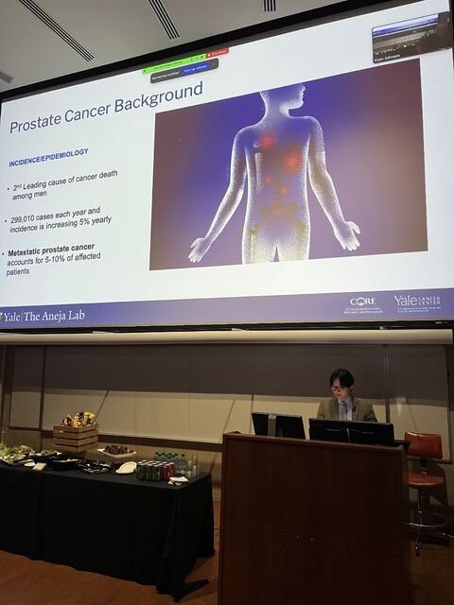
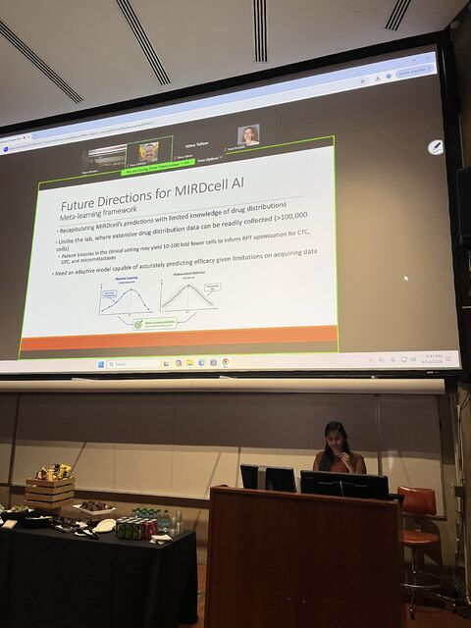
Educational Programs
2026 MD with Distinction participants
PhD in Health AI
MS in AI Healthcare
MD with Distinction in AI
Digital badges and
research experiences
Active at NJMS/coming to RWJMS

Slide 14

Distinction in AI in Medicine
The Distinction in AI Program helps MD students to:
Train in Machine Learning and Artificial Intelligence (ML/AI)
Learn ML/AI applications in healthcare
Engage with AI faculty
Demonstrate AI research skills
Notes:
The Distinction in AI in Medicine program trains MD students in machine learning and AI applied to healthcare. Students train in ML/AI methods, learn healthcare applications, engage with AI faculty, and demonstrate research skills through a mentored project. Our goal is to produce physician-scientists who can lead AI-driven clinical research.

Slide 15
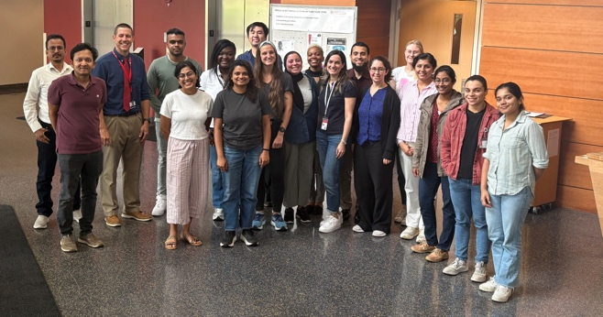
Educational Programs
PhD in Health AI
MS in AI Healthcare
Bootcamp Program
all CLUs are welcome and participated
2025: AI in RNA-seq
(34 students)
2026:
Two Summer Bootcamps
1. AI-guided literature Review
June 1-5, 2026 (15 students)
2. AI in RNA-seq analysis
June 15-19, 2026 (45 students)
Sustainability:
Convert to Digital Badges,
1 credit course
R25 PAR-24-252, October 14, 2026
MD with Distinction in AI
Bootcamps in Health AI

Slide 16
Community Building
Goal e: Symposium
all CLUs invited
PhD in Health AI
Joint Roadmaps Symposium (Dec 8, 2026)
Trainee Symposium (July 31, 2026)
MS in AI Healthcare
Symposia and Seminars
Summer
Internships
(BS,MS)
Annual BMIHAI Symposium
(May 13, 2025
March 23, 2026)
“Health AI” monthly seminar series
Bootcamp in Health AI

Slide 17
Rutgers Health AI Virtual Seminar Series
Second Thursday of each month 5:30-7pm
Ice breakers followed by a seminar
Connect faculty, staff, and students interested in AI research.
Emphasis on junior faculty

Slide 18

Community Building
Symposium
Industry partnerships
established
PhD in Health AI
Highlights:
- Trainee mentorship session over lunch
- Poster Awards + oncology Poster Awards (lots of excitement)
MS in AI Healthcare
Symposia and Seminars
MD with Distinction in AI
Bootcamp in Health AI

Slide 19
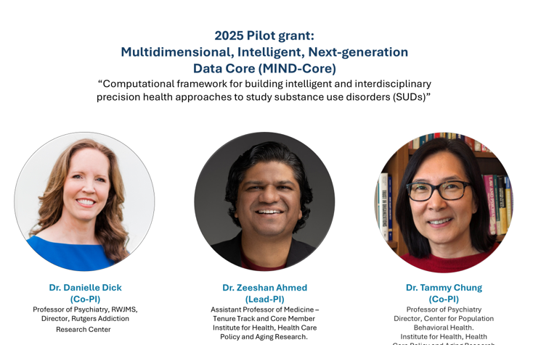
Grant making
2025 Example Pilot grant
PhD in Health AI
Highlights:
2026 – 3 proposal selected
(28 applications received)
2026 funded proposals:
AI in post-stroke rehabilitation
AI-guided microbiome analysis
in triple-negative breast cancer
AI-driven pharmacokinetic/
Pharmacodynamic modeling
Sustainability:
NJ ACTS partnership
MS in AI Healthcare
Symposia, Seminars,
FutureMed
Goal h: Pilot grant:
New, multi-disciplinary,
cross-CLU collaborations
2025 – 3 proposals funded
(18 applications received)
Pilot grants
in Health AI
MD with Distinction in AI
Bootcamp in Health AI

Slide 20
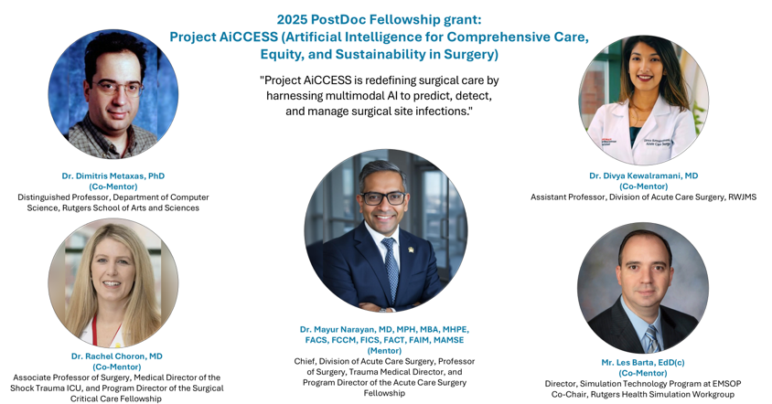
Grant making
First R01 Funded from grant activities: Jason Yang!
Example PostDoc fellowship grant
2026 funded proposals:
AI in gene regulation in ASD
AI for epigenomics and metabolomics
of cardiometabolic changes
in HIV-exposed infants
AI to study brain
connectome in
psychosis
AI to study brain function
and upper
extremity rehabilitation
Sustainability:
T32 PA-25-168,
January 25, 2027
PhD in Health AI
PostDoc fellowship
MS in AI Healthcare
Symposia, Seminars,
FutureMed
Goal i: PostDoc Fellowships:
New, multi-disciplinary,
cross-CLU collaborations
around the PostDoc fellowships (4 /year)
2025 – 4 proposals funded
(19 applications received)
2026 – 4 proposals funded
(15 applications received)
Pilot grants
in Health AI
MD with Distinction in AI
Bootcamp in Health AI

Slide 21
Foundational Pillars of BMIHAI
Education & Training:
Cutting-edge degree programs, internships, and
specialized training in bioinformatics and AI to prepare the next generation of healthcare and biomedical professionals and
researchers.
Social-Technical Infrastructure: Building Living Laboratories integrate clinical, educational, research, and commercial environments.
Research & Innovation:
Driving research that leverages AI and
machine learning to develop new insights, enhance diagnostics, and
improve health
outcomes.

Slide 22




Clinical and Research Data Warehouse (CRDW)
Unstructured Data
Rutgers Protected Environment
Radiology Images
Data Extraction &
Transformation
Coming soon:
CDRW 2.0
Improving
Access to
healthcare data
Digital Pathology
High Performance Computing
Data Storage
Genomics Profiles
Analytics and Indexing
Correlated Clinical EHR Data
Secure Cloud Services
(AWS, GCP, Azure)
Clinical Research Data Warehouse
(CRDW)
Optimize and maintain the CRDW as a robust informatics platform that supports multimodal (genomics, digital pathology, radiology) data management and data-mining capabilities that advance translational research and clinical investigations.

Slide 23
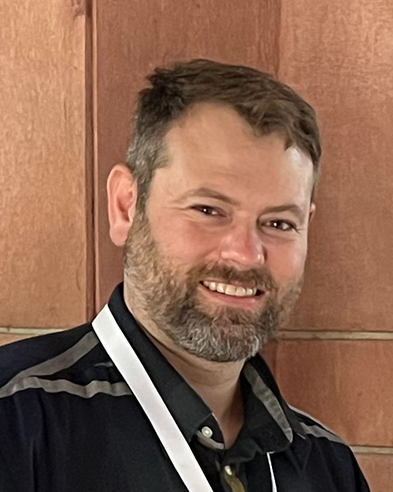

HUB ONE
Data Science Hub
VISION
Arthur VanValkenburg, PhD
Howard Fan, PhD
CURRENT HUB EXPERTISE
A complement to our analytical core facilities for projects needing long-term computational collaboration, novel analyses, and specialized scientific expertise — pairing experimental and clinical investigators with embedded data scientists.
AI / Machine Learning
Bioinformatics
Statistics
RNA-seq / scRNA-seq
STRUCTURE
Human & microbial genetics
R Shiny development
Rutgers computational faculty + dedicated Hub research scientists
Engaged on a %-effort basis as full collaborators on your team
Membership and skills grow continuously with new investigators
Batch-effect correction
Metagenomics
Howard Fan, PhD
Immunology
Infectious disease (HIV/TB)
Cancer genomics
Cardiovascular & addiction
Hub members and skills are growing constantly — reach out even if the expertise you need isn't listed yet.

Slide 24


HUB TWO
LLM/Agentic AI Hub
VISION
Xutao Wang, PhD
Solomon Joseph
AI HUB CAPABILITIES
The same embedded-collaborator model, focused on artificial intelligence: dedicated GPU infrastructure and AI engineers that bring generative and agentic AI, large-scale modeling, and cloud capacity to clinical and translational research.
Generative AI
Agentic AI
Large language models
GPU / HPC compute
STRUCTURE
Foundation-model fine-tuning
ML pipeline engineering
Two dedicated AI engineers + on-premise GPU compute nodes
Cloud partnerships with AWS and Google for scale and tooling
Engaged as long-term collaborators, mirroring the Data Science Hub
RePORT analysis prototype
Cloud (AWS / Google)
Retrieval & RAG systems
Model evaluation
Data platform engineering
Secure clinical AI
Built on Year 1–2 roadmap investments with the Center for Biomedical Informatics & Health AI (BMIHAI).

Slide 25
Living Laboratories
Hedge Hog Principle
  Interests, Skills, and Funding Opportunities are aligned at Rutgers
Ethical Plus AI
  Ethical/Responsible AI
  Achieve synergy between AI and Humans through integration in complex adaptive systems (Kasparov’s Law)
  Address deskilling/never skilling through use of digital twins

Slide 26
Foundational Pillars of BMIHAI
Education & Training:
Cutting-edge degree programs, internships, and
specialized training in bioinformatics and AI to prepare the next generation of healthcare and biomedical professionals and
researchers.
Social-Technical Infrastructure: Services that integrate clinical, educational, research, and commercial environments.
Research & Innovation:
Driving research that leverages AI and
machine learning to develop new insights, enhance diagnostics, and
improve health
outcomes.

Slide 27
Targeted recruitment into transformative research programs
Living
Laboratories
Digital
Twins
An AI-enabled Learning
Health and Research System
An AI-enabled Medical
and Science Education System

Slide 28
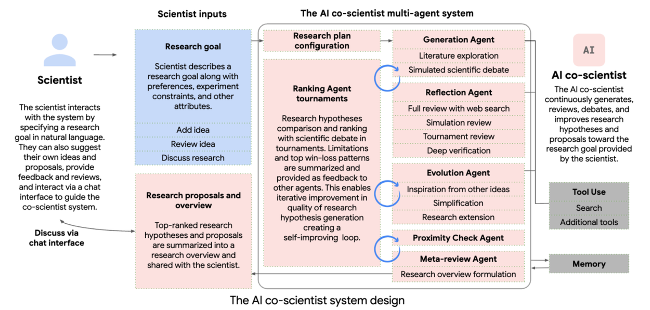
The AI co-scientist (Google): AI masters the meta-processes of science to become a team member
Digital twin of lab-based science

Slide 29
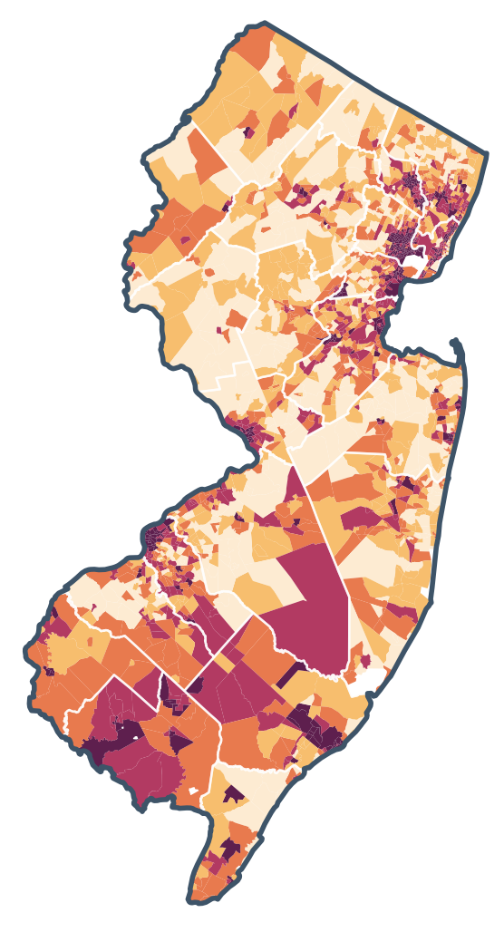
ROBOTIC SURGERY
WHERE NEED IS GREATEST
Newark Beth Israel Medical Center
Clara Maass Medical Center
Newark
Belleville
Jersey City Medical Center
WITHIN 10 MILES OF A ROBOTIC SURGERY PROGRAM
Cooperman Barnabas Medical Center
Jersey City
79%
60%
7
1
Livingston
5
3
Trinitas Regional Medical Center
1
Elizabeth
in New Jersey’s most socially vulnerable communities
of New Jersey residents overall
RWJUH Somerset
3
2
Somerville
10
RWJUH Rahway
Rahway
9,000+
44
RWJUH New Brunswick
6
New Brunswick
Monmouth Medical Center
patients treated in 2025
da Vinci systems
1
Long Branch
RWJUH Hamilton
2
Hamilton
Monmouth Medical Center Southern Campus
12
138
3
hospitals
robotic procedure types across specialties
Lakewood
Community Medical Center
Toms River
WHERE NEW JERSEY LIVES
New Jersey’s population is concentrated along the northeastern and central corridor, including Newark, Jersey City, Middlesex, Monmouth, and Ocean counties. RWJBarnabas Health’s robotic footprint closely overlaps with these population centers.
6 of New Jersey’s 10 most populous counties have a da Vinci program inside their borders.
LOWER
HIGHER
CDC/ATSDR SOCIAL VULNERABILITY INDEX — 2022 · NEW JERSEY CENSUS TRACTS
RWJBarnabas Health logo
place approved reversed lockup here
Marker numbers are da Vinci systems in place at that hospital · Fleet data as of July 2026 · Shading: CDC/ATSDR Social Vulnerability Index 2022, all 2,165 New Jersey census tracts ranked against one another · 138 procedure types is 2026 year-to-date
Notes:
Robotic footprint against social vulnerability — RWJBarnabas Health. 44 da Vinci systems, 12 hospitals.
SHADING: CDC/ATSDR SVI 2022, RPL_THEMES, New Jersey census tracts (2,175 total; 2,165 with valid rankings and population). Tracts are ranked against other NJ tracts, not nationally. Quintile bands: 0-.2, .2-.4, .4-.6, .6-.8, .8-1.0.
PROXIMITY (tract representative points, tract population, straight-line): all NJ residents {"10":60.3,"15":72.2,"20":78.1,"25":81.7,"30":86.2}. High-vulnerability tracts (SVI >= 0.75; 542 tracts, 2,189,276 residents): {"10":79.1,"15":82.3,"20":82.7,"25":83.3,"30":86.5}. Top decile (SVI >= 0.90, 860,606 residents): 82.5% within 10 miles.
HEADLINE: 79.1% of high-vulnerability residents are within 10 miles, against 60.3% of NJ residents overall — the network sits closer to vulnerable communities than to the state at large.
HOSPITAL SITING (SVI of the tract each stands in): Newark Beth Israel 0.97 · RWJUH New Brunswick 0.89 · Trinitas 0.89 · Monmouth Medical 0.88 · RWJUH Rahway 0.78 · RWJUH Somerset 0.77 · Clara Maass 0.72 · Jersey City 0.64 · RWJUH Hamilton 0.60 · Cooperman 0.55 · Monmouth South 0.45 · Community Medical 0.44.
KNOWN GAP: ~16.7% of high-vulnerability residents are beyond 25 miles, concentrated in Camden (6.8% of the high-SVI population), Atlantic (4.3%), Cumberland (3.5%) and Salem (0.6%). Passaic (10.6%) and Bergen (5.5%) have no hospital but fall largely inside 25 miles.
ENVELOPE: union of 10-mile radii, clipped to NJ = 24.3% of state land area. Population inside it: 60.1% of all NJ residents, 79.1% of residents in high-vulnerability tracts (SVI >= 0.75). Dots: 542 top-quartile tracts, area proportional to tract population; 420 of 542 dots and 79.1% of that population fall inside the envelope. Choropleth shading was rejected because tract AREA does not track POPULATION -- dense urban high-SVI tracts are geographically tiny and rural ones are large, which made the shaded version read as though the need were concentrated in the south.
QUOTE BLOCK AND LOGO ARE PLACEHOLDERS.

Slide 30

Surgical
Robotics
and
Digital Twins
Intraoperative
data capture
Base anatomic model
EHR
CT/MRI imaging
Vital signs
Video
Control movements
Meta data
AI abstractions
Cluster hire of faculty
Through BMIHAI
Drives Innovation
Patient digital
Twin with
Surgical
Record
Safety
Signals
and Outcome
Data
Enhanced skills
Surgeon’s
digital twin
Simulation training
Virtual surgery
Technical skill development

Slide 31
Transitioning from Animal Models to New Approach Methodologies (NAMs)
NAMs Conversion Lab
Induced Pluripotent Stem Cells (iPSCs): Somatic cells (like skin or blood) reprogrammed into stem cells.
Organoids (3D Cultures): iPSCs or primary cells are grown into complex, three-dimensional structures that mimic the architecture and function of actual organs (e.g., "mini-brains" or "mini-livers").
Organ-on-a-Chip: These microfluidic platforms integrate cellular models with mechanical forces (like blood flow or breathing) to simulate the physiological environment.
"Cell Villages": Emerging techniques use pooled cell lines from diverse individuals to conduct large-scale "clinical” trials to study different genetic backgrounds.
Precision-cut organ slices: This technique retains more of the complexities of real-world tissues and may guide the transition from cellular systems to full-scale animal models.
Literature synthesis and
model comparisons
Hands-on training
Standards, standardized
experiments and results sets
Simplified analytical tools
Select: similarity measures
of bionetwork topology
Select: conservation of
regulatory mechanisms
in experiments
Cost and risk to benefit
ratios for model systems
Animal
model
Prep-> Practice -> Select ->Validate
NAMs

Slide 32
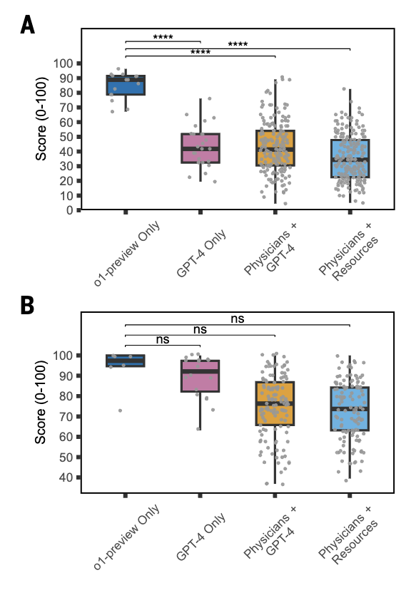
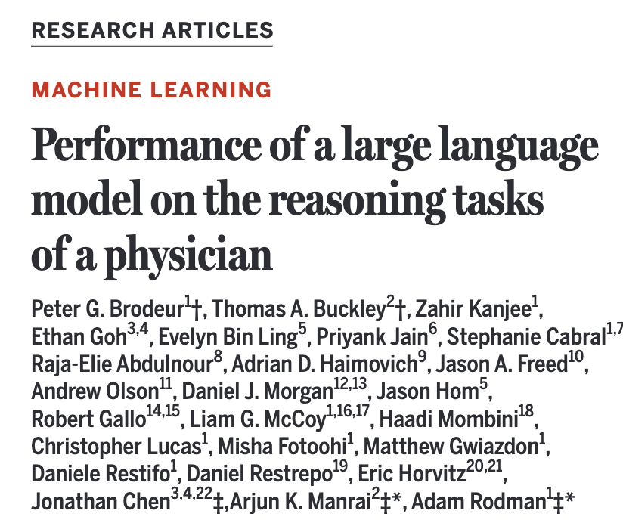

LLMs outperform many physicians and diagnosis and therapy

Slide 33
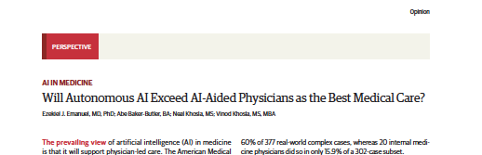
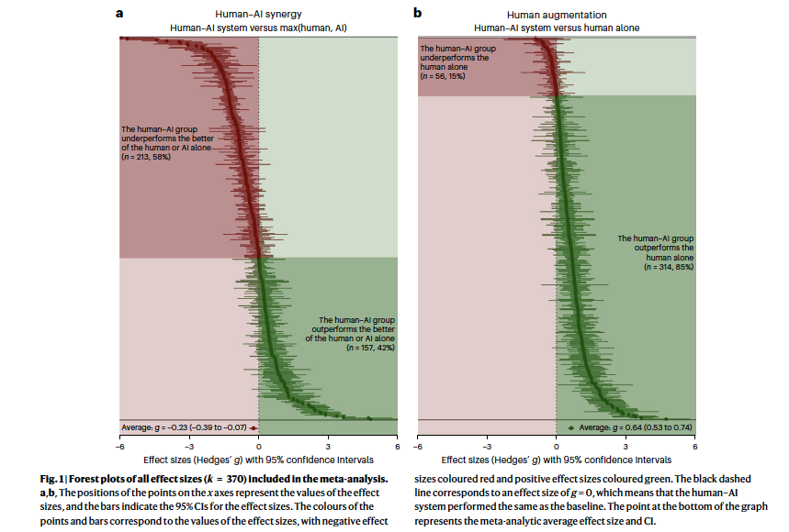
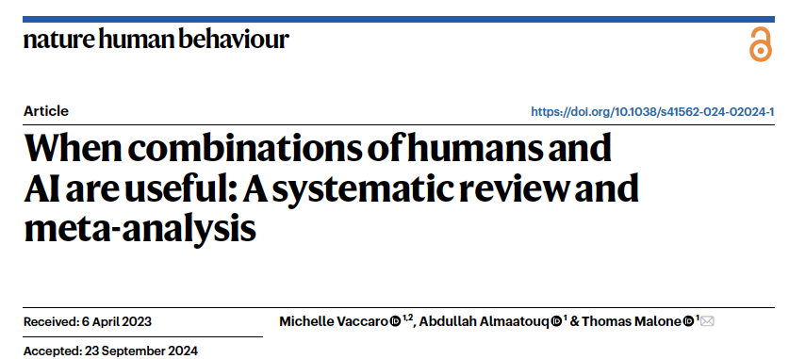
Human – AI systems combinations may not be additive or synergistic

Slide 34
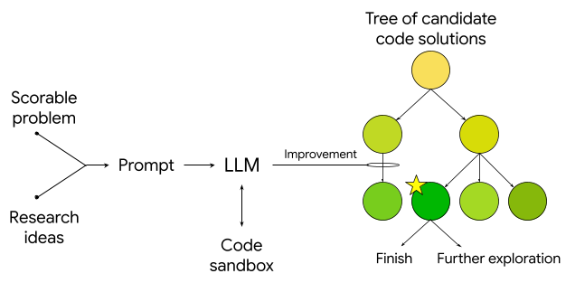
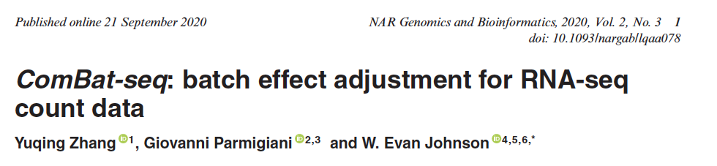
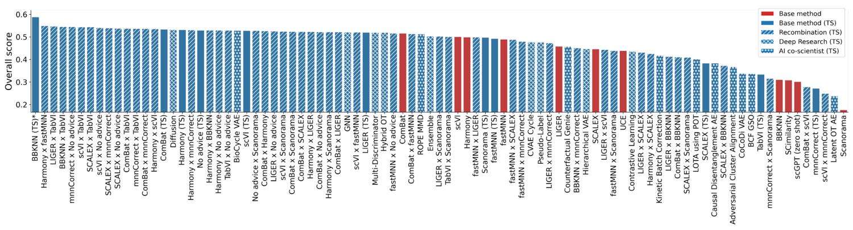
AI can advance science:
Evan Johnson’s innovations in RNA-seq.
https://research.google/blog/accelerating-
scientific-discovery-
with-ai-powered-empirical-software/
RNA-seq
Batch file
analysis
performance

Slide 35
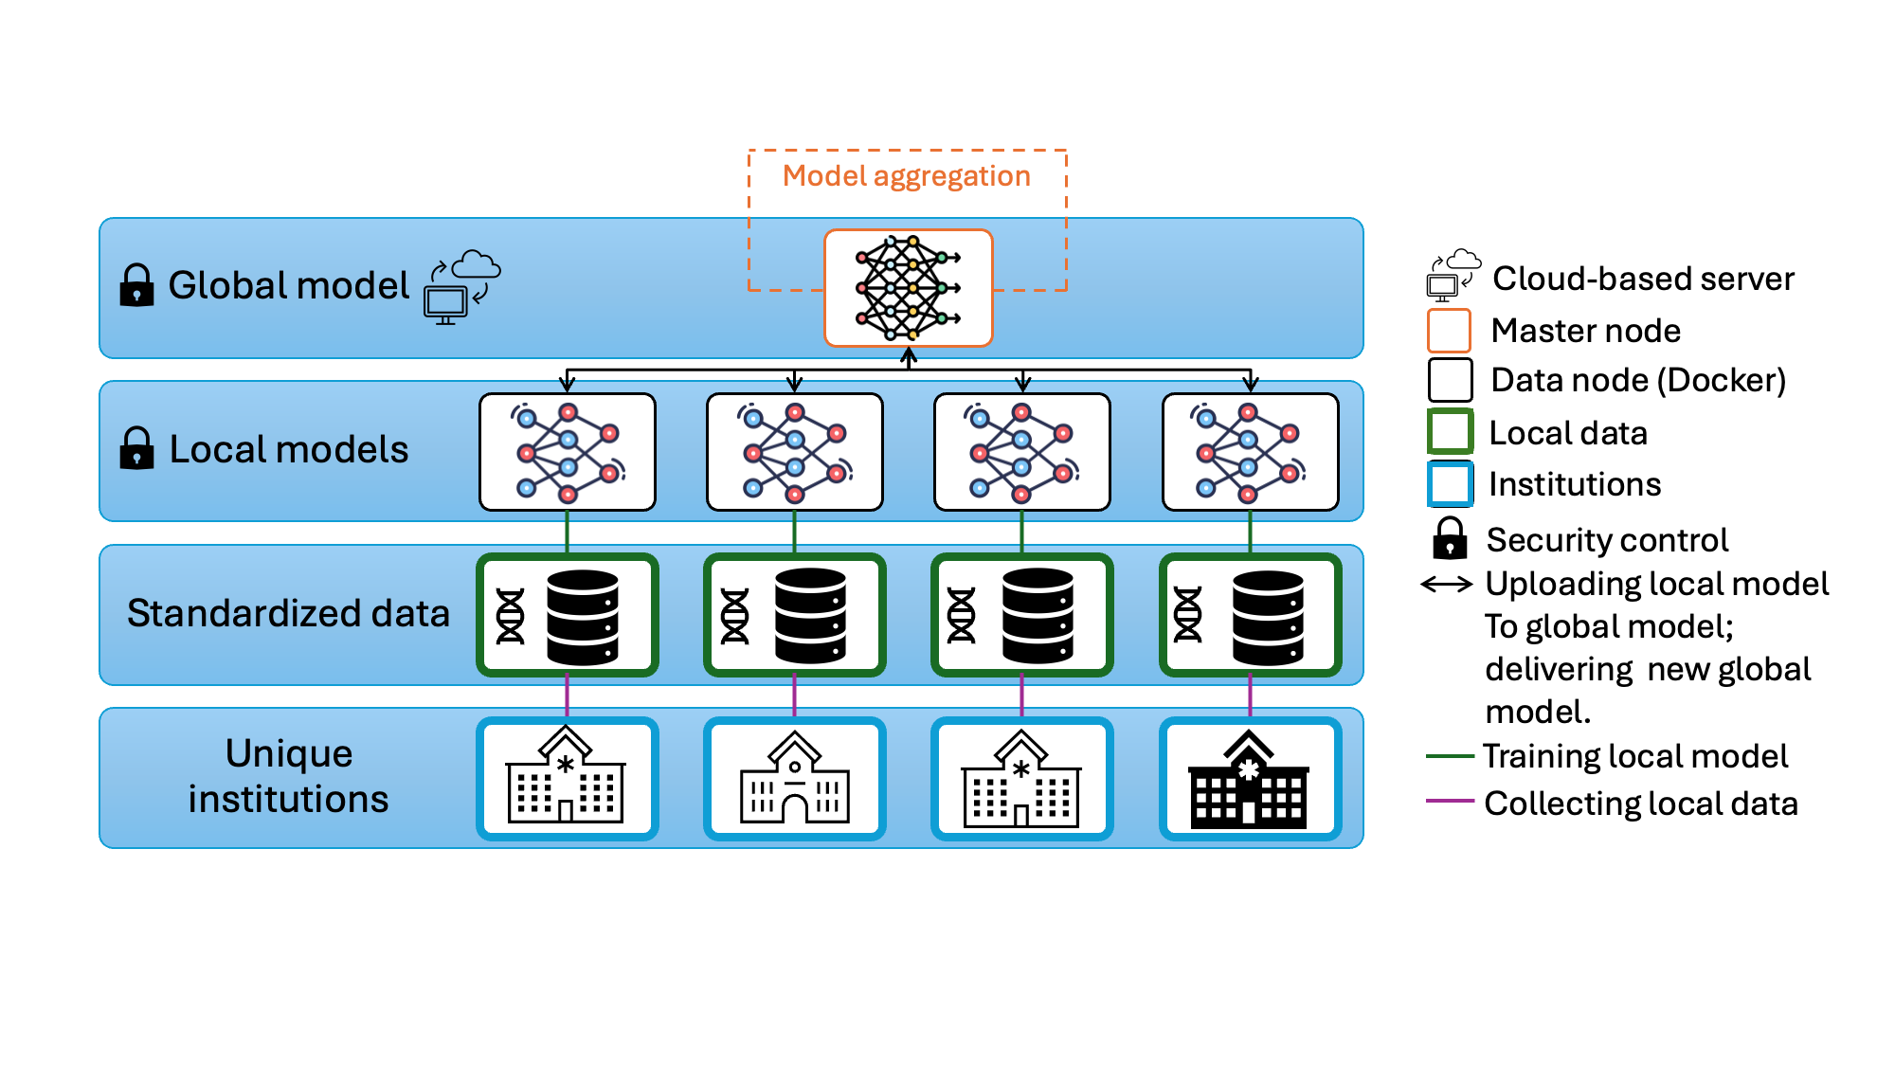
Tuberculosis (TB) Research
Federated, AI-driven platforms for global TB discovery (RePORT International)
Novel TB Biomarkers: new signatures for progression, treatment response or failure, pediatric TB
TB SignatureProfiler & curatedTBData: resources with more than >100 TB signatures; 50+ harmonized transcriptomic experiments; 5,000+ samples
Federated platform for RePORT: containerized FL clients across India, Brazil, South Africa, Philippines
Federated GLMs (HyFed + FedFitGLM): privacy-preserving regression across sites
Cross-site harmonization: Federated ComBat-Seq and EdgeR for multi-cohort -omics
Agentic AI: LLM-driven code generation with safe execution for distributed TB analytics
Federated learning architecture for RePORT International TB data
Notes:
Our TB research integrates federated data platforms with AI methods across many international sites — India, Brazil, South Africa, and the Philippines. curatedTBData harmonizes more than fifty TB transcriptomic studies with over five thousand samples, and we're building federated GLMs (HyFed + FedFitGLM) plus federated ComBat-Seq to enable joint analyses while respecting site data sovereignty. Most recently we've added agentic AI: LLM-driven code generation with a safe execution layer for distributed analyses across these sites.

Slide 36
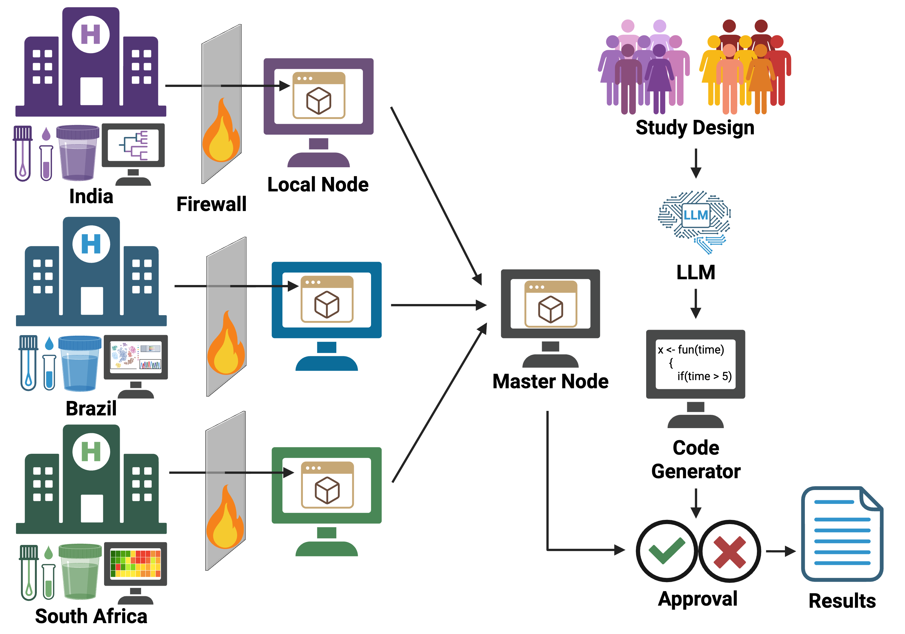
TB Research AI Alliance
Unifying clinical, imaging, and research tuberculosis data across the Northeast and turning it into AI-ready evidence.
TB is the top killer due to infectious disease
Link data across clinics
Federated Data Sharing
Advanced statistical methodology
AI-driven code generation and analysis
Notes:
The TB Research AI Alliance unifies clinical, imaging, and research tuberculosis data across institutions in the U.S. Northeast. TB is the world's top infectious killer, and the alliance links data across clinics through federated data sharing, advanced statistical methods, and AI-driven code generation. Together we turn distributed clinical and research data into AI-ready evidence.

Slide 37






Partners: TB AI Alliance
Notes:
Our partners span clinical, technology, and AI infrastructure: Rutgers Global Tuberculosis Institute and Boston Medical Center lead the clinical and research side, while Google Health, NimbleMind.ai, and Databricks bring AI platforms and scalable data engineering. Each partner contributes a distinct capability to the federated TB ecosystem.

Slide 38
Collaborate with BMIHAI
Come to Rutgers!
Joint bootcamps and short courses
  Co-taught in Riyadh and at Rutgers
Visiting trainees and faculty
Co-supervised students
  PhD in Health AI, MS in AI in Healthcare
Shared TB data and federated analysis
  RePORT International, TB AI Alliance
Joint grant mechanisms - KAIMRC and beyond

Slide 39




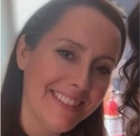

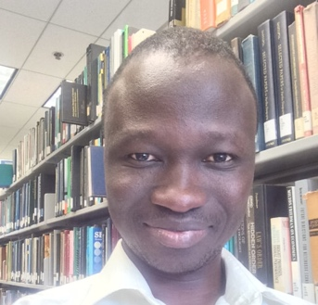


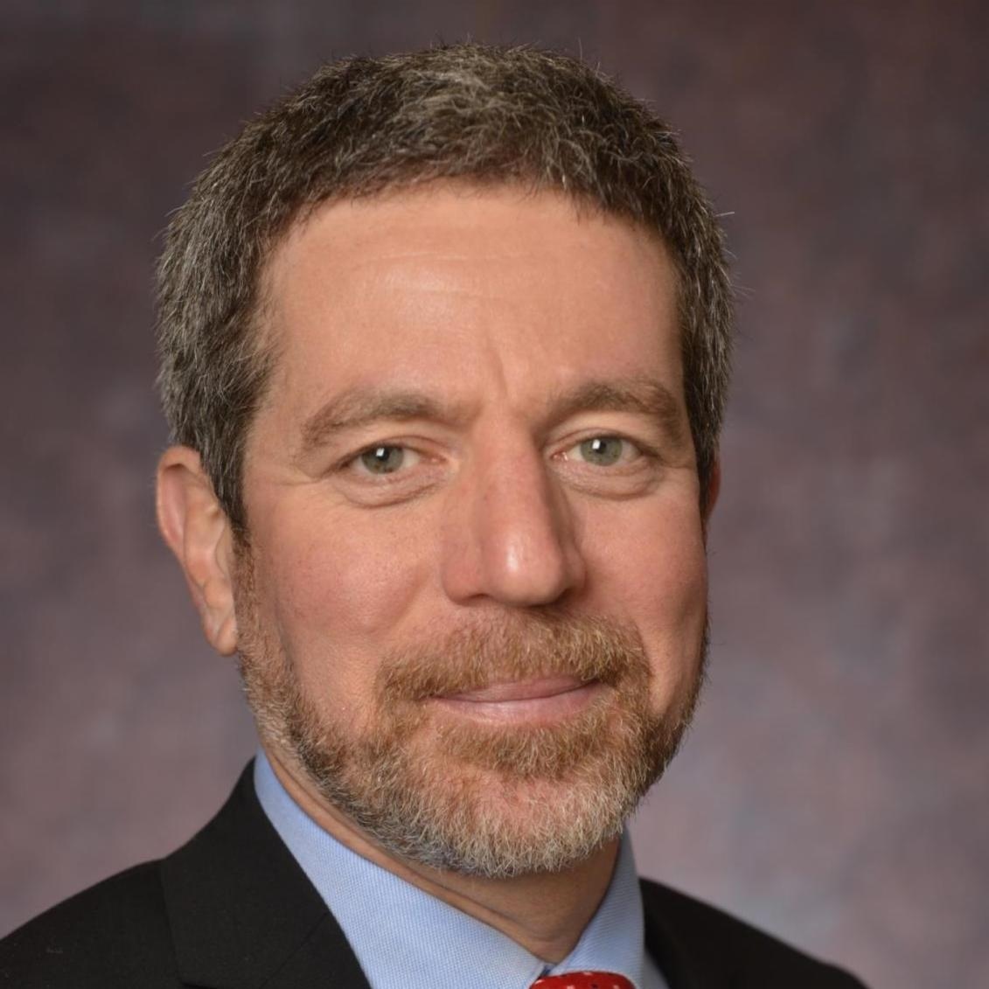






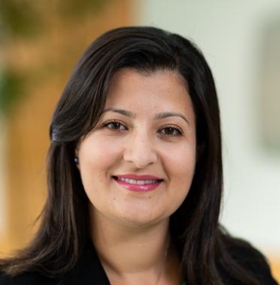
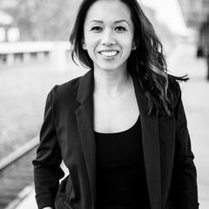
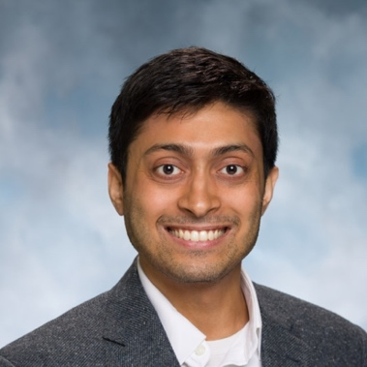
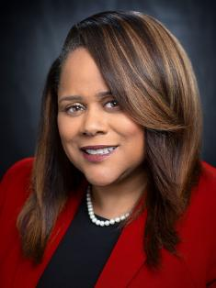
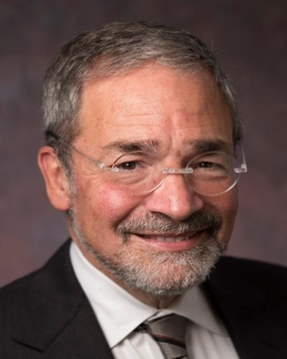
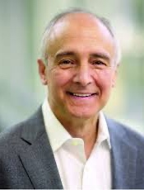
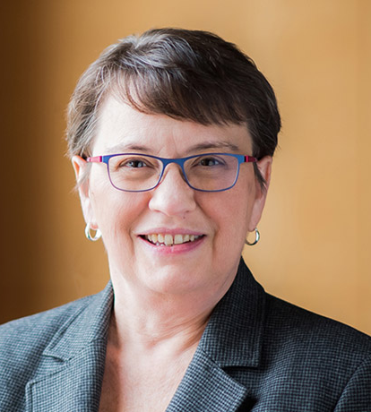
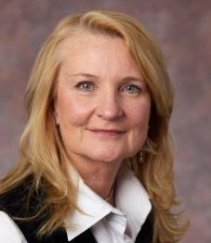

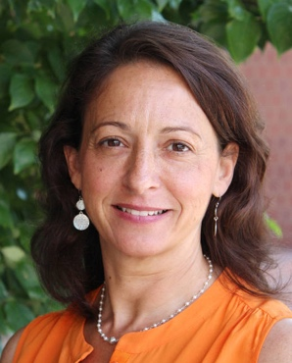
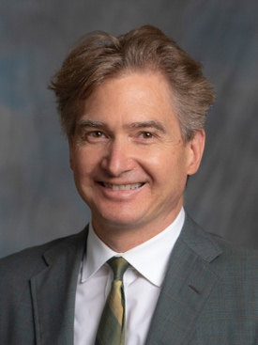
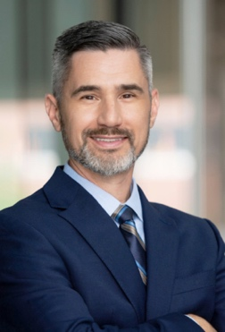
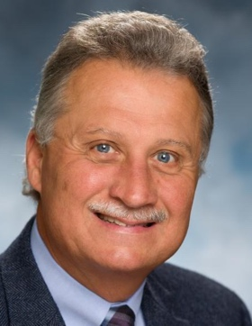
Gratitude to our Support Team and Leadership!

